Slide 1

Browser history
AbhinAV krishna vp
Am.en.u4cse22006

Slide 2


implementing a browser history management system using a doubly linked list.? needs to support the following functionalities:
Initialization
Forward tabs
Visit tabs
Back tabs

Slide 3

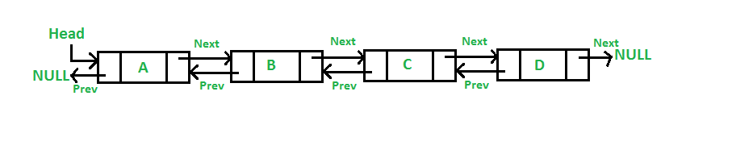
Data structure
DOUBLY LINKED LIST
A doubly linked list is a type of linked list where each node contains a reference to both the next node and the previous node. This allows for efficient traversal in both directions (forward and backward).

Slide 4
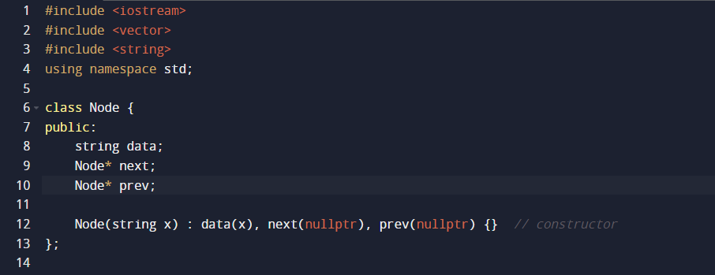
NODE CREATION

Slide 5
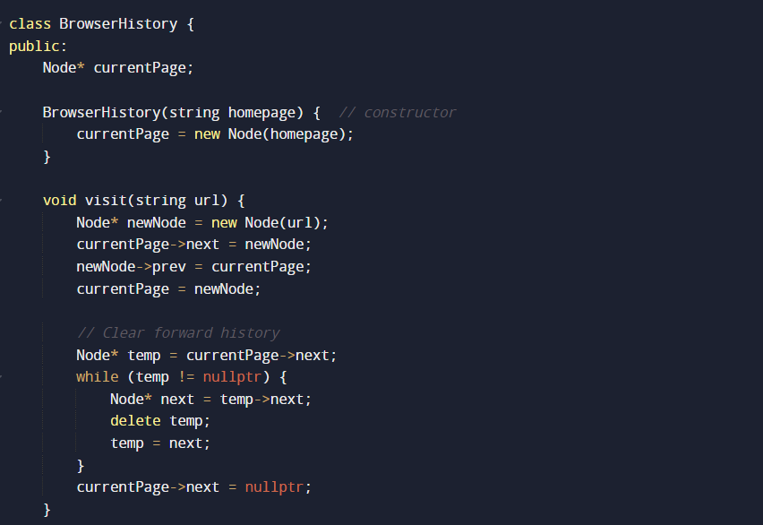
FUNCTION

Slide 6
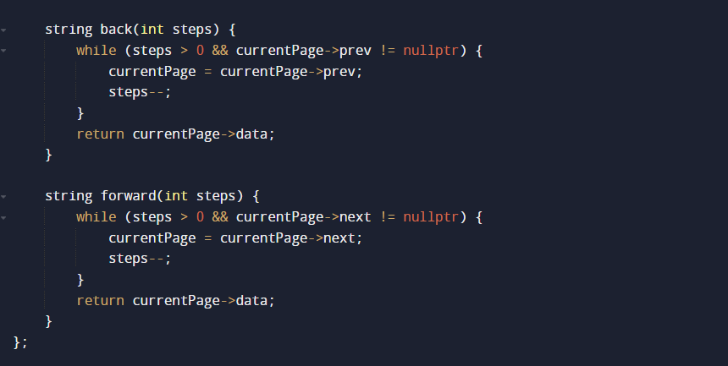
FUNCTION

Slide 7
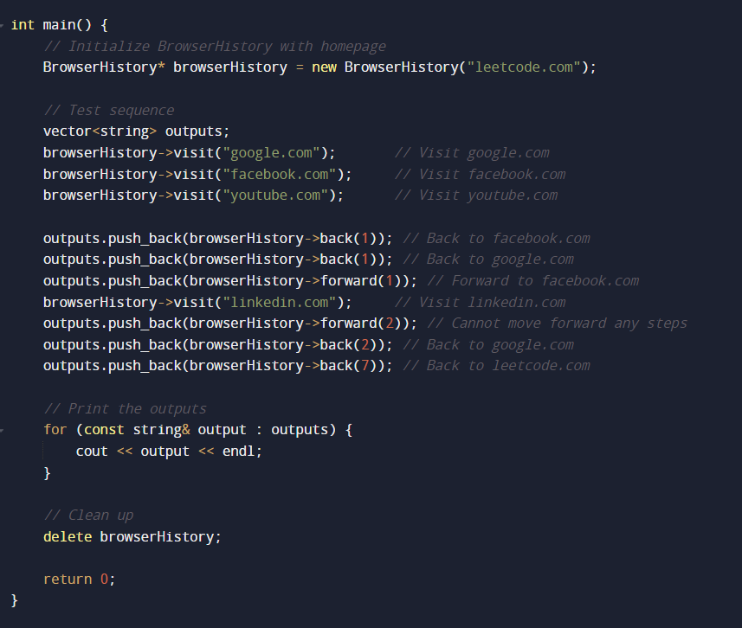
Main funCtion

Slide 8

THANK YOU

